Slide 1
UNDERSTANDING TRAUMA
Reverend Traci Jackson
Executive Director
Domestic/Sexual Violence Project
Urban League of Eastern MA

Slide 2
Responses to trauma
Physical
Spiritual
Psychological
Emotional

Slide 3
.
Helpful vs. Hurtful

Slide 4
.
PTSD: Post Traumatic Stress Disorder

Slide 5
.
Vicarious Trauma

Slide 6
Community Agreements
Listen Deeply
Maintain Confidentiality
Prioritize Safety
Respect Interfaith Setting
Share the Air
Take Care of Yourself
No One Gets to Know it All
Assume Good Intentions and Address Impact
Survivors of Abuse Are So Much More

Slide 8
Overall Agenda
1 - Defining Trauma
2 - Trauma Informed
3- Historical Trauma in Communities of Color
4- Impact of Trauma
5- Break
More about Trauma
The Intersection of Faith and Abuse

Slide 9
What lies beneath??
Defining Trauma

Slide 10
What lies beneath??
Trauma Informed?

Slide 11
What lies beneath??
Intergenerational Trauma

Slide 12
Grounding Ourselves
A deep breathing meditation
to start our session.

Slide 13
Breathe
What happens to the body?
Notes:
3 minutes AMK
Explain the goals and objectives of our training
Be able to define and recognize trauma
Understand the traumatic impacts of abuse.
Be able to identify different ways that people may respond to trauma (four ways)
Learn warning signs of abuse and skills to respond safely and helpfully to someone experiencing abuse.

Slide 14
Aspects of Trauma
Acute Trauma
Chronic Trauma
Complex Trauma
Collective Trauma
Historical/Generational Trauma
Vicarious Trauma
Notes:
5 minutes AMK
Thus, when defining trauma, it is also important to understand that there are different types of trauma, as they may impact each person differently. Additionally, there could be compounding traumas happening at the same time.
(1) Acute trauma – This trauma occurs from a single event.
Accident
Natural disaster
Single act of violence or terrorism
Sudden unexpected loss, such as the death of a family member, friend, pet, etc.
(2) Chronic trauma - Traumatic experiences that are repeated and prolonged
Prolonged family or community violence
Long-term illness
Chronic bullying
Chronic poverty and related stressors
Exposure to war, torture, or forced displacement
(3) Complex trauma - Complex trauma is often seen in cases of intimate partner violence and includes exposure to varied and multiple traumatic events, often of an invasive, interpersonal nature
Ongoing physical, emotional, and sexual abuse
Ongoing neglect by caregivers
Witnessing domestic violence, like a child witnessing the DV of a parent
Other forms of chronic violence without support
(4) Collective trauma– refers to the psychological reactions to a traumatic event that affect an entire society; it does not merely reflect an historical fact, the recollection of a terrible event that happened to a group of people.
War
Pandemics
Climate Crisis
(5) Historical/Generational Trauma - refers to the cumulative emotional, physical, sexual, and spiritual harm of an individual or generation. Often manifests through the systematic oppression of particular groups. Is passed down through generations.
Slavery + Segregation
Misogyny
Racism
Colonialism
Genocide
(6) Vicarious trauma - Vicarious traumatization is a negative reaction to trauma exposure and includes a range of psychosocial symptoms.
Hearing about the trauma of others
This can be something faith leaders encounter frequently, so it is important to check in with yourself and practice self-care when caring for your congregation.

Slide 15
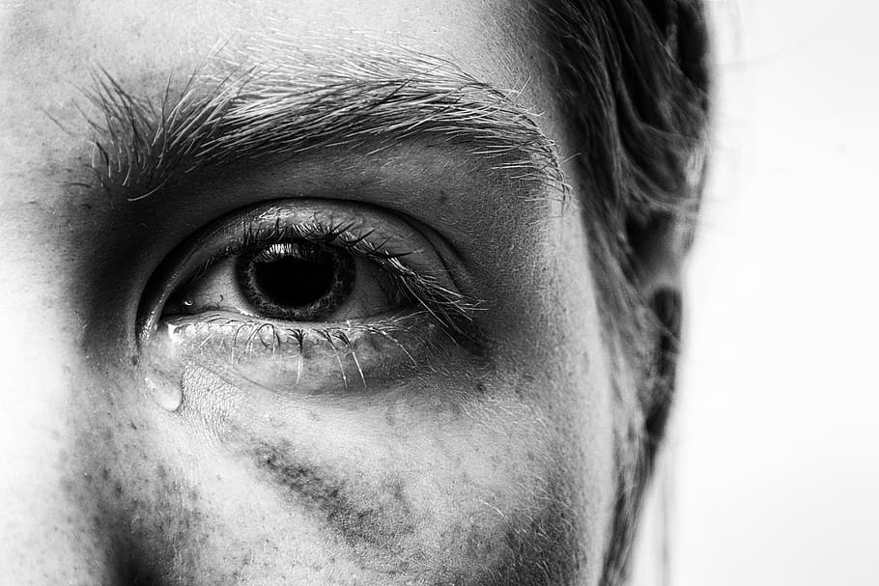

Slide 16
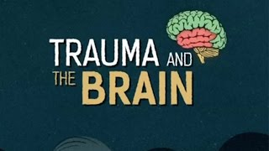
TRAUMA

Slide 17
Closing
Wrap-Up
Questions and Answers
Notes:
3 minutes AMH
Today’s Goals
Be able to define and recognize trauma.
Understand the traumatic impacts of abuse.
Learn warning signs of abuse and skills to respond safely and helpfully to someone experiencing abuse.
Upcoming Training
June 5, 2023 from 6 - 8 pm
Evaluations https://docs.google.com/forms/d/e/1FAIpQLSc-jv5Fbxd087TYtG1Q_LQgWNprviwwhZpdzdXrmBAXd6bcoQ/viewform?usp=share_link
[Put evaluation link in the chat]

Slide 18
Contact Info:
Thank You
Rev. Traci Jackson
tuppertra@aol.com
617-459-2420

