Slide 1
The Sexual Assault Forensic Medical Exam
Shalotta Sharp, RN, SANE-A, SANE-P
Special Projects Coordinator
MSCASA

Slide 2
ShalottaSharp@aol.com
205-401-1171

Slide 3

Understanding the Patient
More than physical
Engaging with patients where they are
Trauma Informed approach

Slide 4
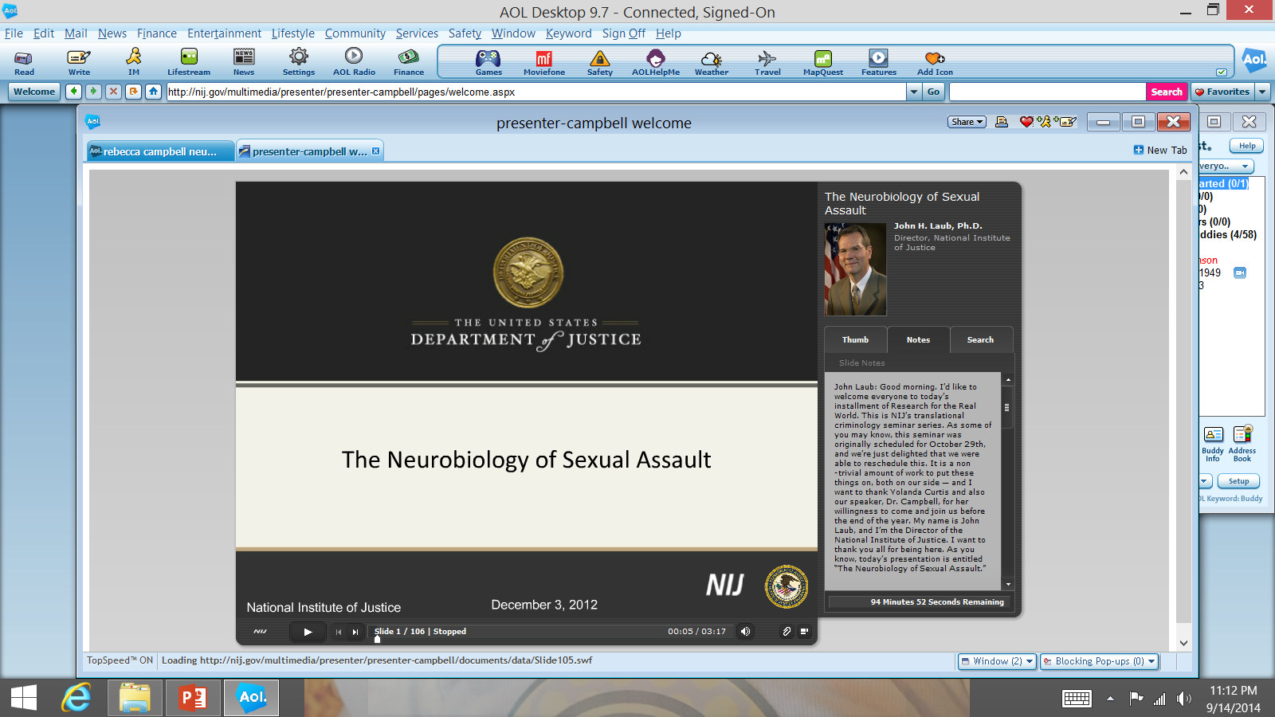
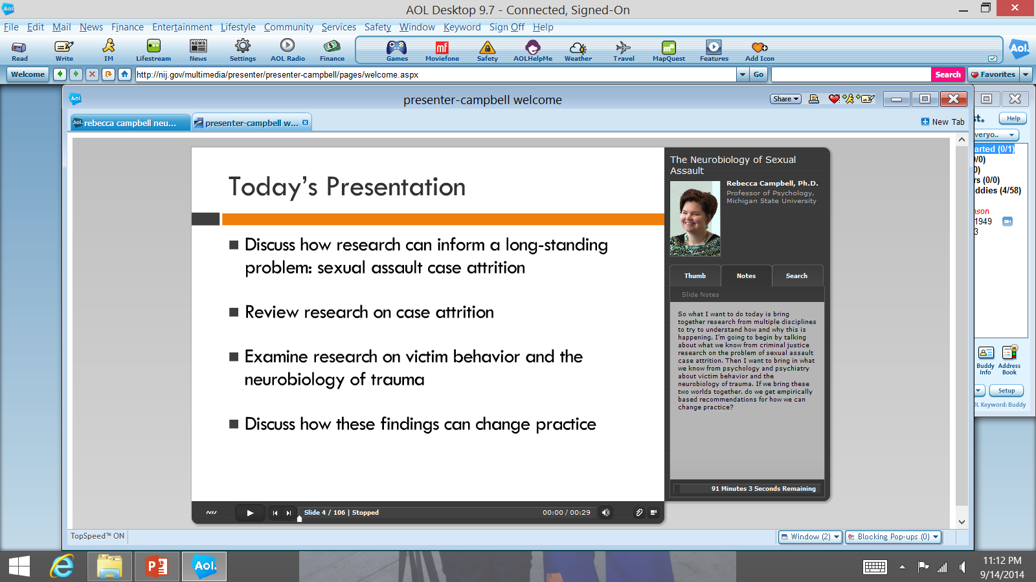

Slide 5
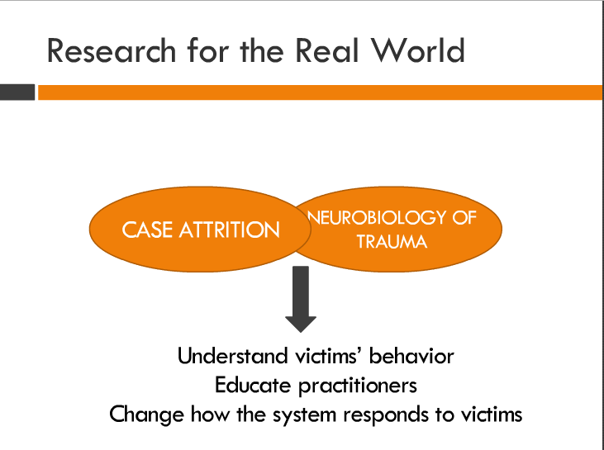

Slide 6
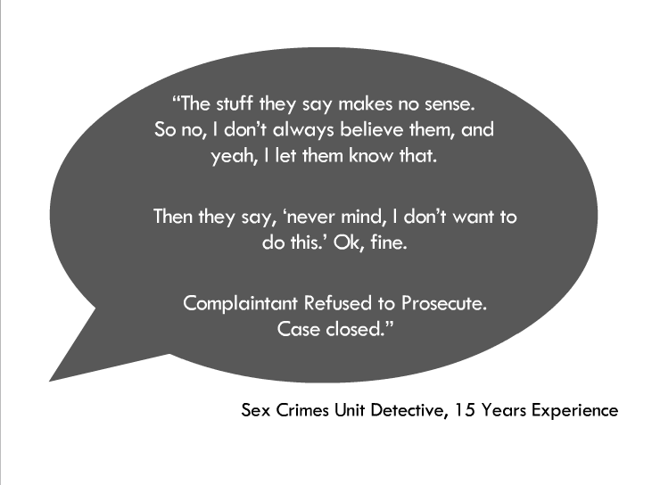

Slide 7
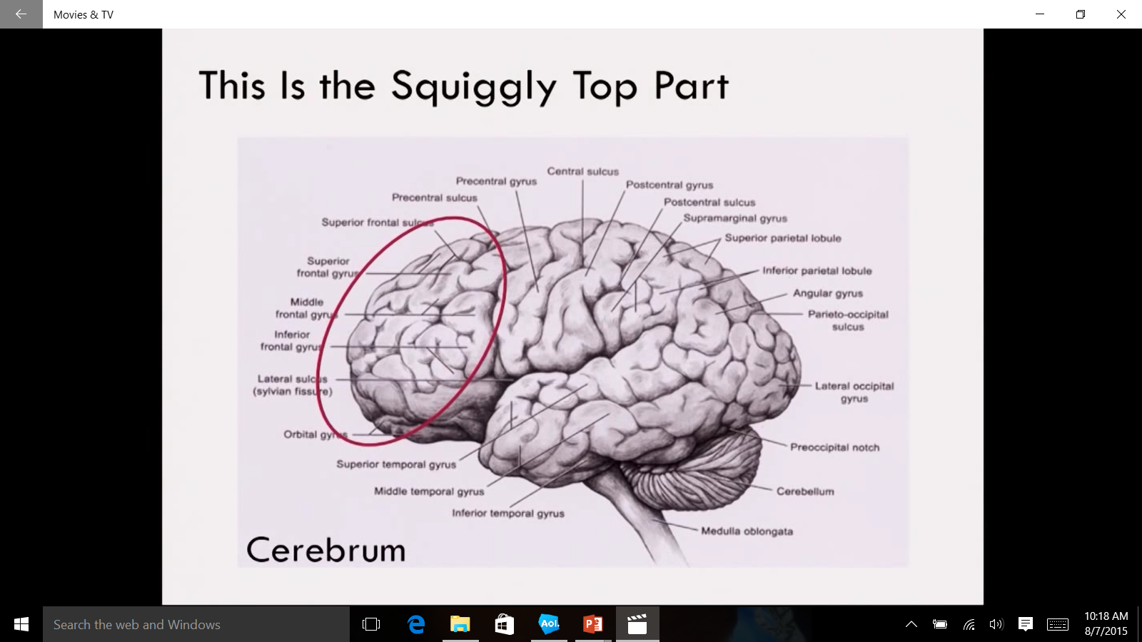
Decision Making…..

Slide 8
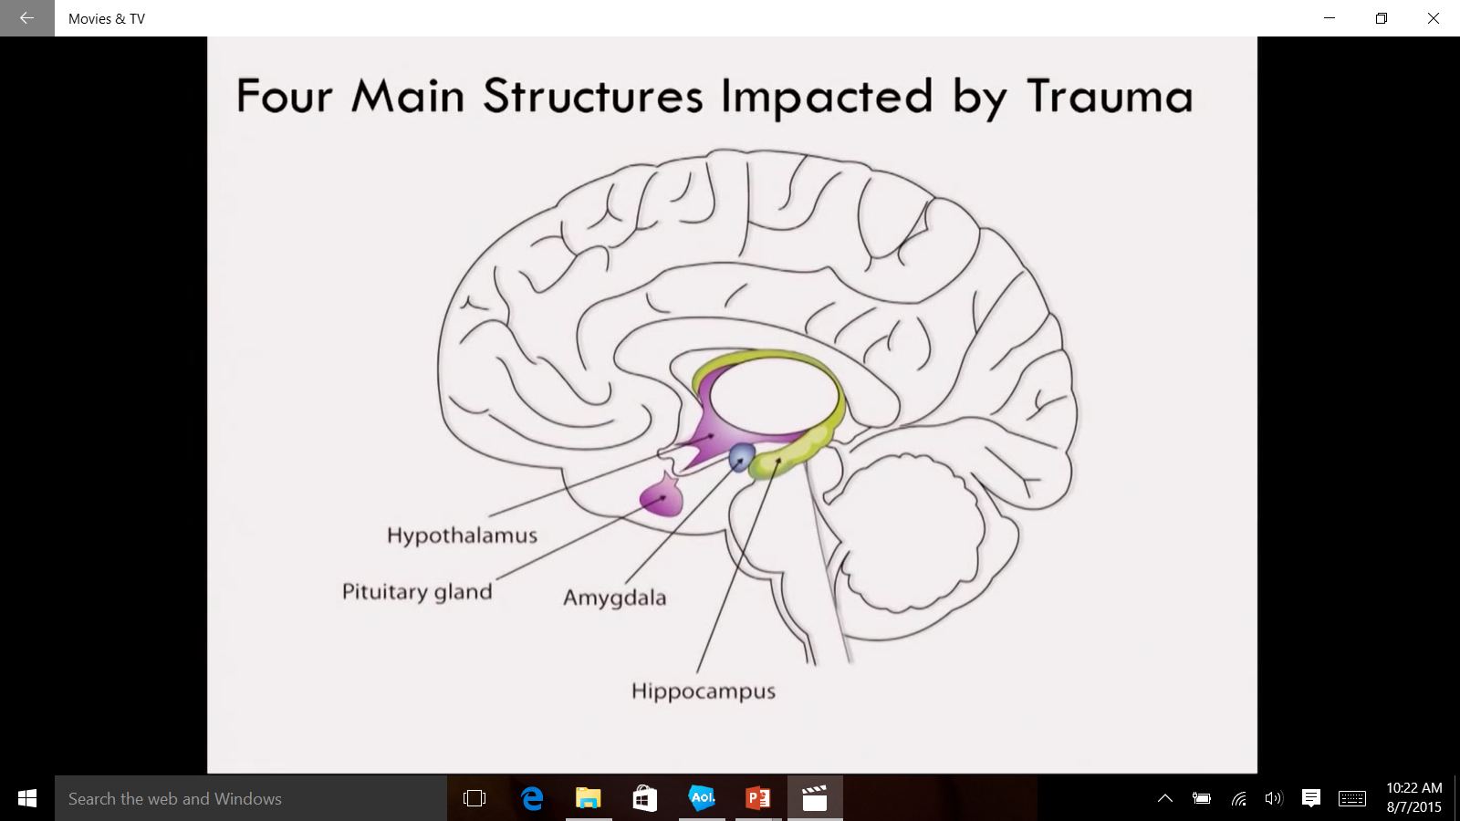
Amygdala: Scans environment for threats.
Hypothalamus: Information switching station.
Pituitary Gland: Master gland for all other glands-including adrenals.
Hippocampus: Stores
memories

Slide 9
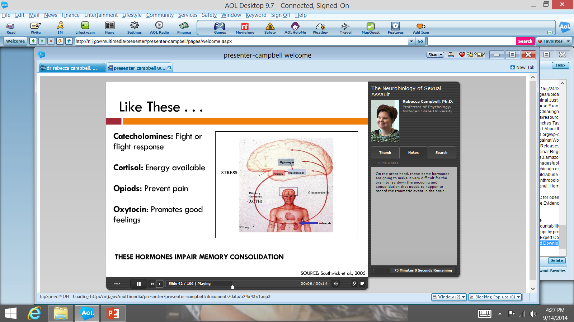
Exactly What do they do…
Catecholomines: The adrenaline dump
Cortisol: How much energy is available
Opoids: Blocks pain….and everything else…no emotion
Oxytocin: The “feel good” hormone…to handle the stress (nursing moms, runners high)
**THERE IS NO CONTROL OVER THE LEVELS!

Slide 10
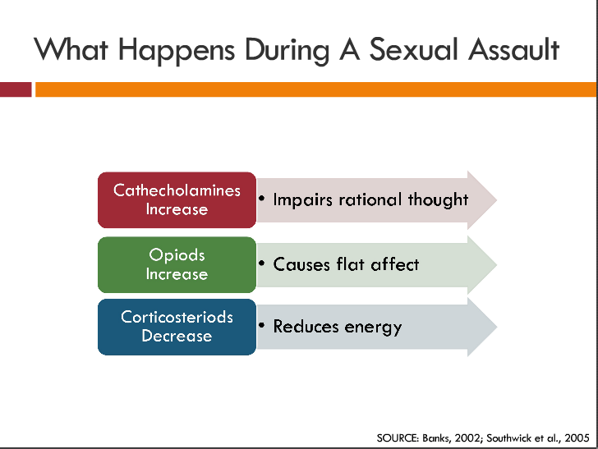

Slide 11
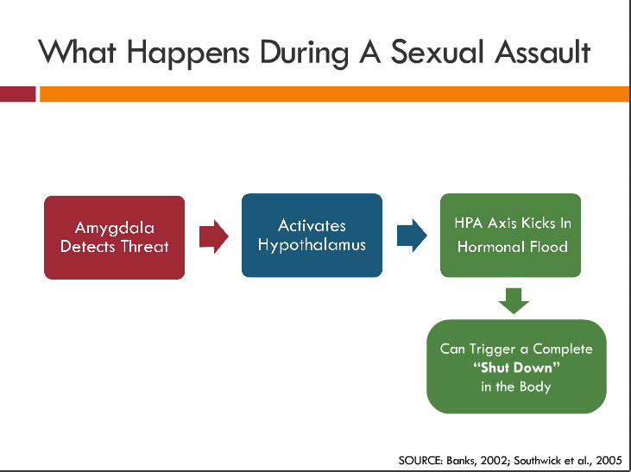

Slide 12
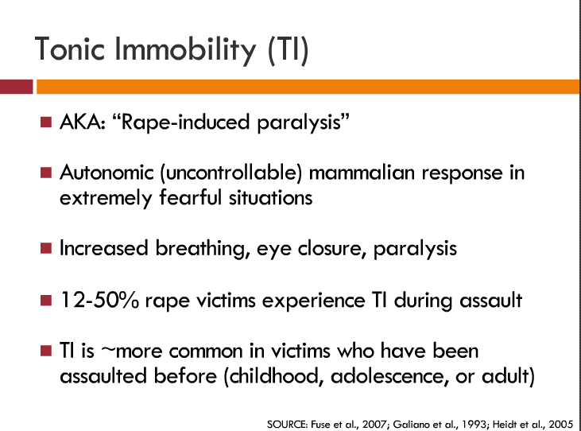

Slide 13
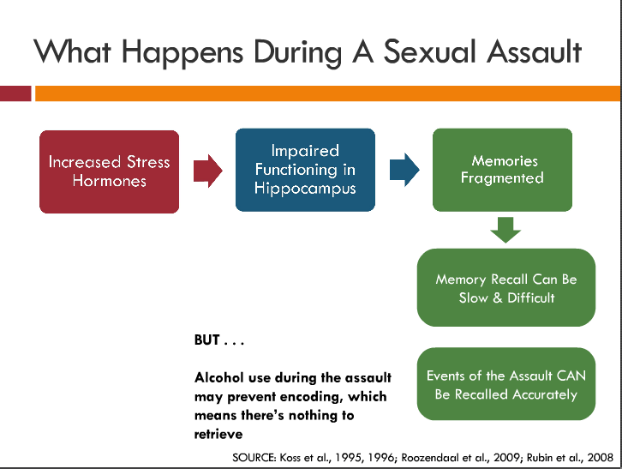

Slide 14
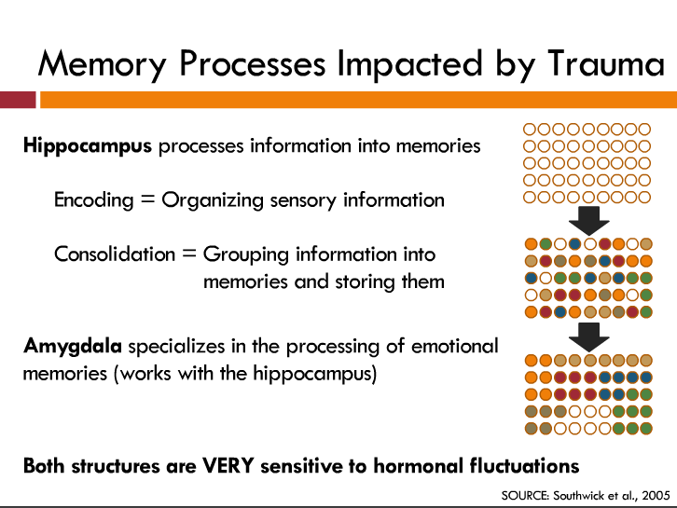

Slide 15
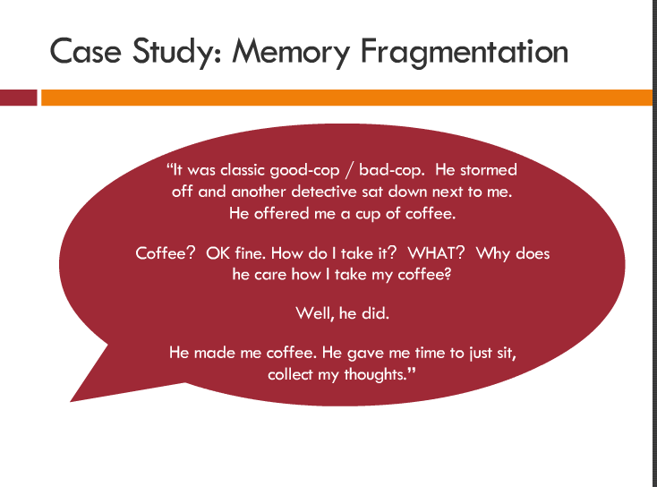

Slide 16
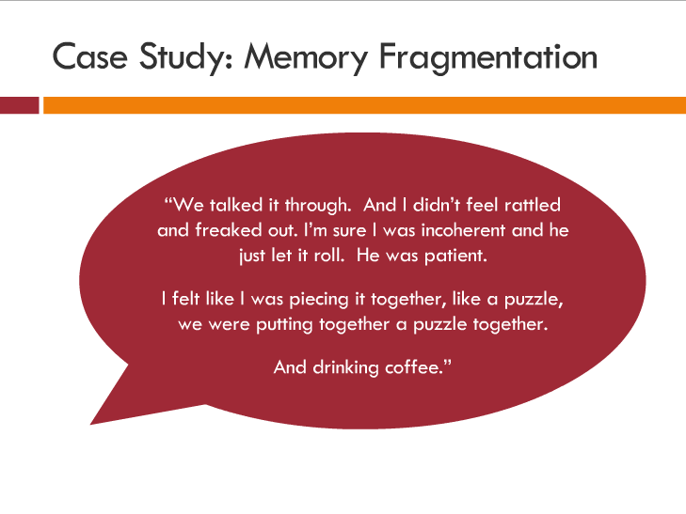

Slide 17
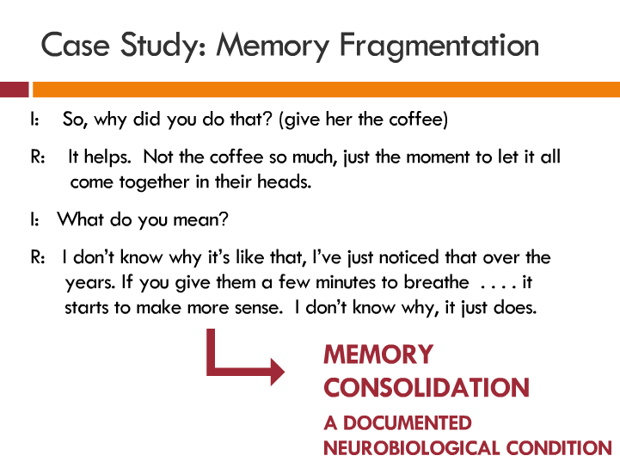

Slide 18
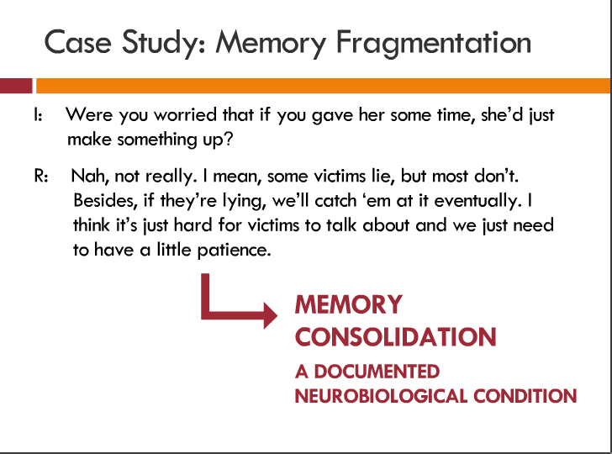

Slide 19
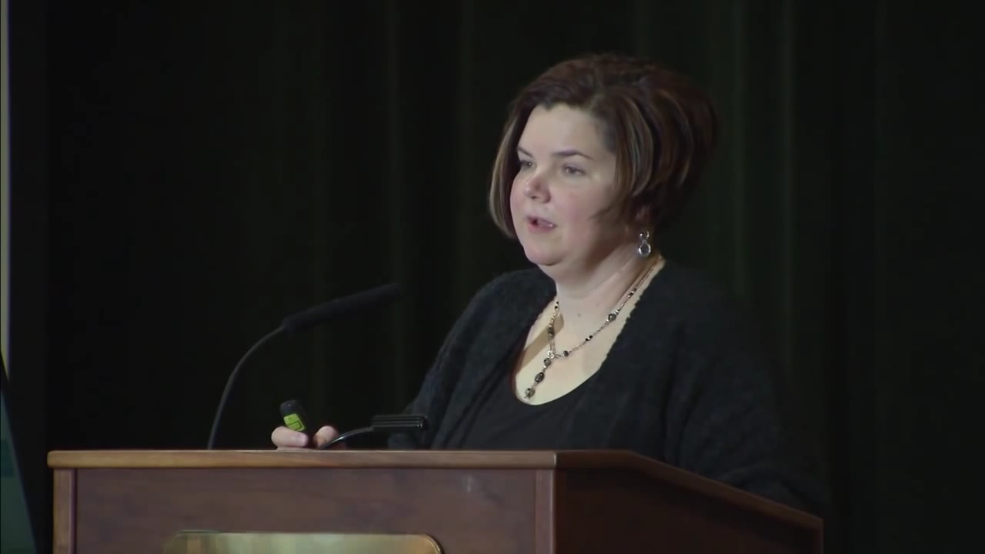

Slide 20
Gathering a History
Understand the status of the victim
How would you want to be questioned?
What are you asking?
What are YOU uncomfortable discussing?

Slide 21
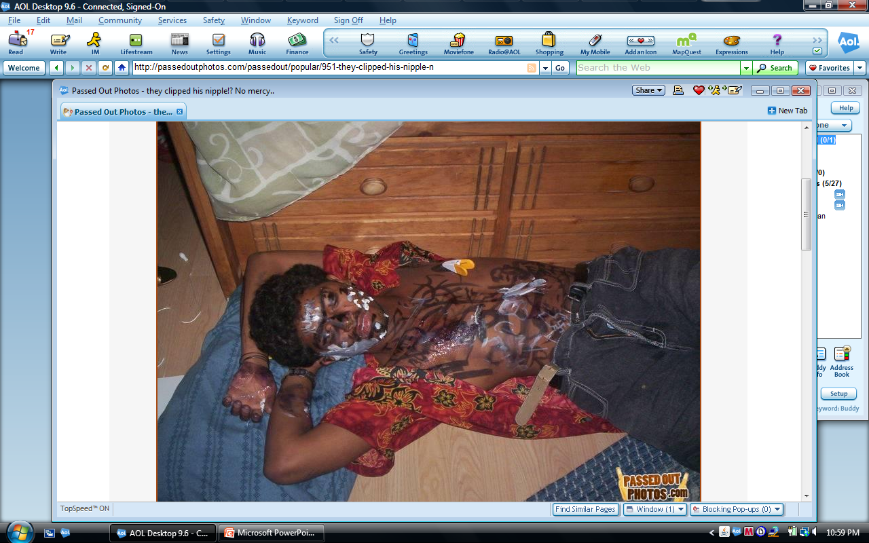
Substance Related Sexual Assault
Nothing new!
ALCOHOL!
New drugs
Whatever is
available:
  Difficult to detect
  Cause amnesia
  Rapid effect

Slide 22
CONSENT-Best for the Patient
What does that look like for each patient!
  Incapacitated
  Age
  Caregivers

Slide 23
The Best Course for the Victim
Have a plan IN PLACE for the victim
Does the Health Facility have adequately trained personnel??
Where is the SANE??
Where is the ADVOCATE??

Slide 24
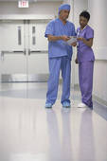
What Happens at the Hospital???
Identification of victim of sexual assault
Emotional support
History of incident
Medical assessment
Forensic collection
Follow up care and referrals
Information

Slide 25
Male Sexual Assault Victims
https://www.youtube.com/watch?v=eFv0NxeHAyo

Slide 26
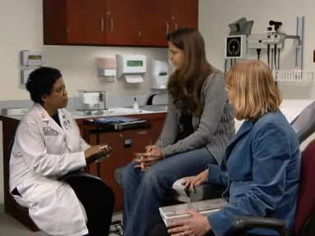
Evidence Collection
96 Hour Time Frame
No out of pocket cost to the Victim
Any RN can provide this service
Both Meridian Hospitals have
SANE’s
Notes:
Proper evidence collection assumes: that you have the tools you need to properly collect, including the kit, gloves, sterile water or saline, seals, labels and packing materials
*remember, if you choose to use saline instead of sterile water, you will need to state that on the crime lab forms, as saline can cause crystallization, which may leave the crime lab personnel wondering if the crystals are from you OR the crime scene. Proper evidence collection also assumes that you understand what to collect, how to collect it, and then how to preserve and package it properly.

Slide 27
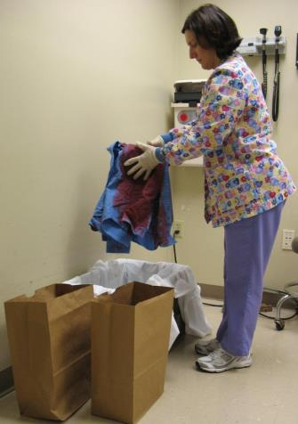
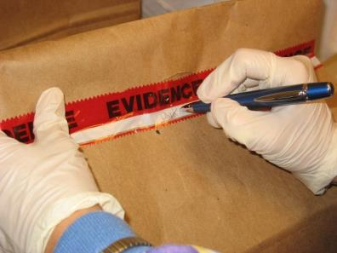
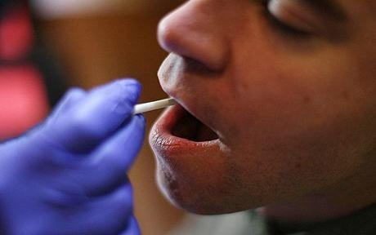
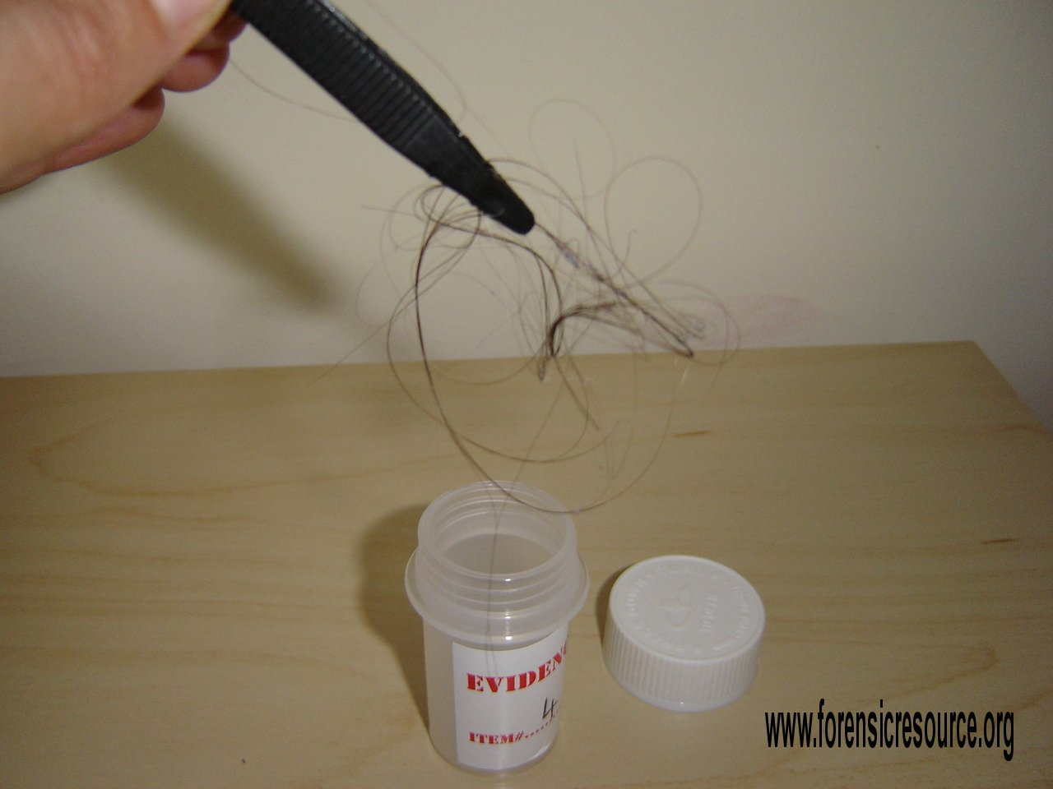
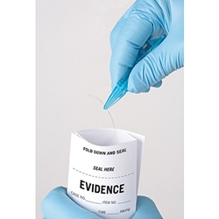
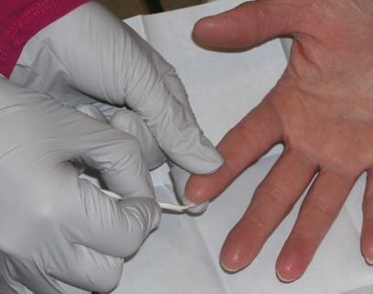

Slide 28
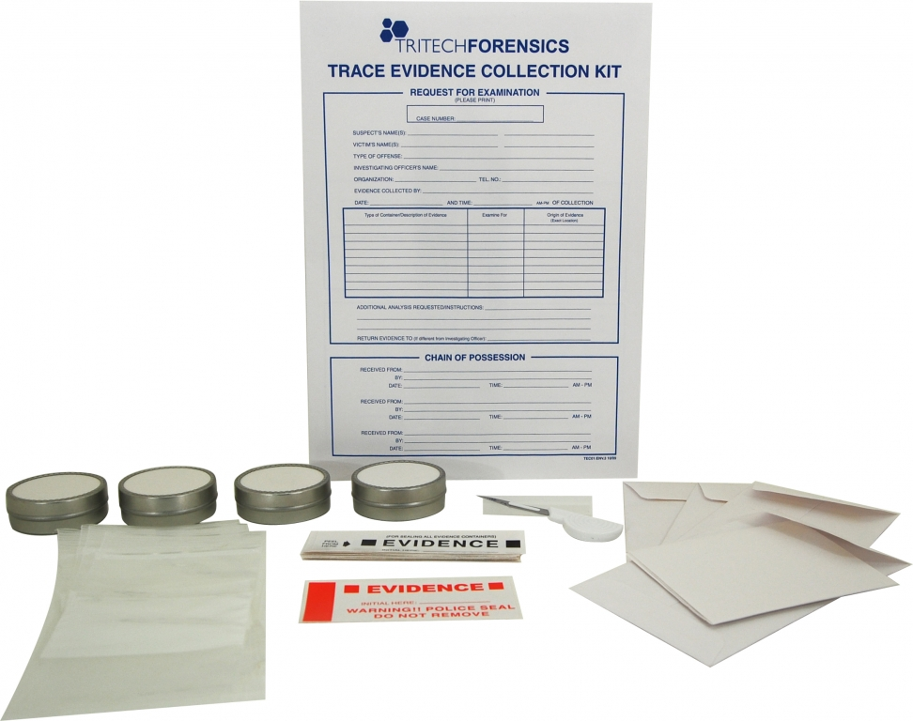
Evidence Kit
Trace evidence
Dried secretions
Bite mark swabs
Oral swabs
Vulvar/vaginal swabs
Rectal swabs
Garments
Combings
Fingernail scrapings
Known samples of head hair,
pubic hair, and blood

Slide 29
Who Gets Assaulted?
Sexual Assault Does NOT Discriminate
Females as well as males are victims
Males are less likely to report
Initiation-Hazing-Harassment
Females as well as males can be/are perpetrators

Slide 30
SELF CARE
IMAGES OF GENITALIA APPROACHING
PLEASE PRACTICE SELF CARE!!!

Slide 31
Male on Male Attacks
Motivated by a need to assert power
Release of aggression
Gang-related
Not usually homosexual, although rape happens in the gay community
Increase in male sexual violence utilized during hazing/initiation rituals (especially athletics)

Slide 32
DON’T REPORT BECAUSE:
Stigma of presumed a gay male
Perceived insensitivity to being gay by law enforcement and healthcare.
Humiliation of being used sexually by another male.
Their masculinity has been threatened because they couldn’t protect themselves.

Slide 33
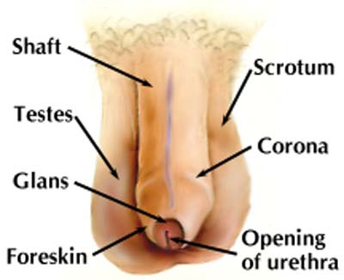

Slide 34
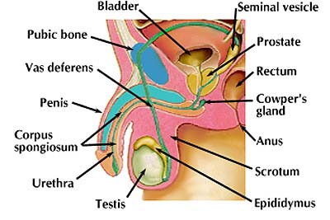

Slide 35
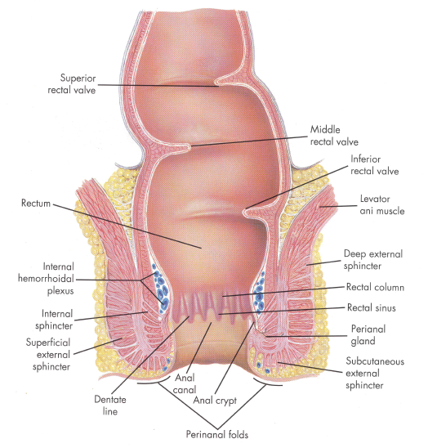
Anus
  Opening at the terminal end of the digestive tract
Notes:
The anus is the opening at the end of the rectum, lying between the buttocks.
The last inch of the rectum is called the anal canal

Slide 36
Facts vs Myths
Sexual Assaults will cause significant injury
We’ve all seen “Law and Order SVU”………
RIGHT??

Slide 37
Ok…..But where are the injuries…….
SELF CARE…..IMAGES APPROACHING……

Slide 38
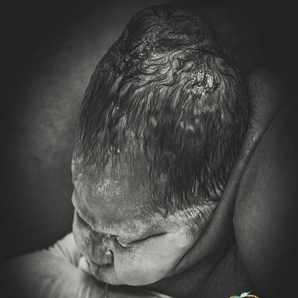

Slide 39
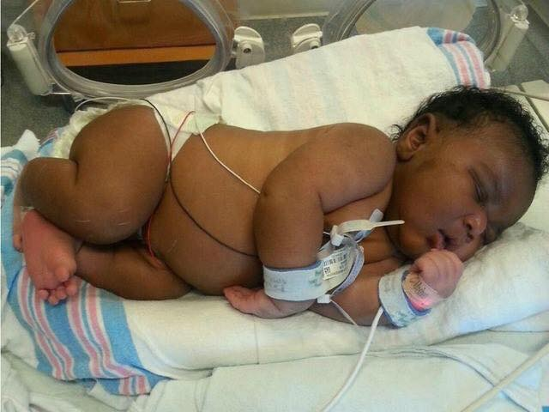
14.1 pound infant
Delivered VAGINALLY
Mother did not know she was pregnant until the third trimester

Slide 40
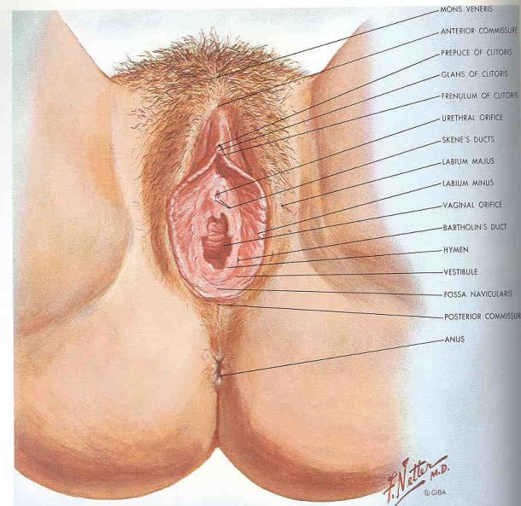
External Genitalia--VULVA

Slide 41
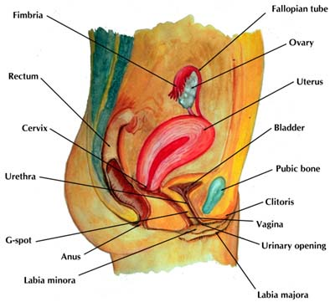

Slide 42

THE AMAZING….hymen
Often misunderstood!
Ring of flesh that surrounds vaginal opening
NOT a membrane or barrier
Changes during puberty because of hormones, especially estrogen
Does not live up to its nicknames….or reputation…..
Notes:
The hymen is simply a piece of flesh. A female is born with a hymen and will die with a hymen. It is not torn away or worn away during intercourse or childbirth.

Slide 43
https://www.youtube.com/watch?v=1ikXim4wevc&t=5s

Slide 44

Hymen of a child
Has a opening- not closed
Very tender, delicate tissue
Easily torn
Heals very quickly- just like the inside of your mouth!
Can be stretched over time
Looks like the “O” ring of a hose
Notes:
Although this tissue is tender and delicate, it heals very quickly and often does not scar. If you bite the inside of your mouth, think how quickly that heals, with no scarring. The hymen is the same way. Many times children will have no injury found by the time they are examined.

Slide 45
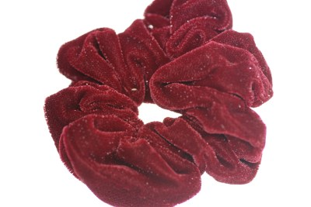
Hymen of teen/ adult
Becomes soft, fluffy, and puffy
Hard to tear with a penis
Stretches a great deal
You cannot tell if a teen/adult is a virgin or not
Often doesn’t tear at first intercourse
Not very sensitive
Looks like a hair “scrunchie”
Notes:
Estrogen is a hormone made by the body at the time of puberty. It causes many changes in the female body. The hymen changes a great deal. It becomes soft and stretchy, and enlarges and often has many folds. The hymen is now able to stretch enough to admit a penis or a baby without tearing. Because of the shape and consistency, a medical person can NOT look at an estrogenized person and tell if she has ever had sex or not. Medical research has shown that once estrogen affects the hymen, everyone looks very much alike- those who have had sex, and those who have not.

Slide 46
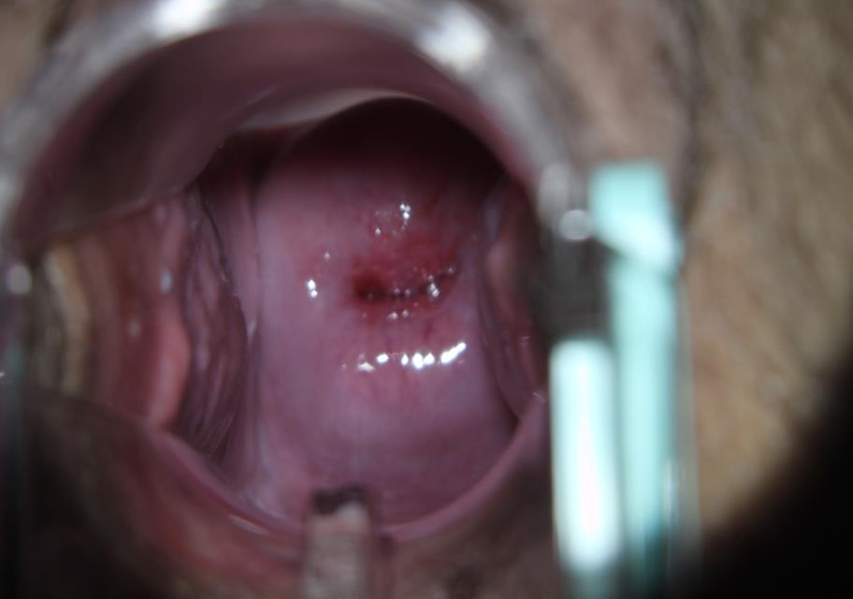

Slide 47
Genital injury
Genital trauma occurs most often to the external genitalia
  Used to be referred to as “mounting injury”
  Location 3-6-9 o’clock most often
  Soft tissue
  Trauma where least resistance

Slide 48
Examiner Tools
Toludine Blue Dye: General nuclear stain (adheres to the second layer of epithelial cells in mucous membrane tissue—such as the female genitalia and anus.
Colposcope: Magnification device to view the genitalia and see injuries that would otherwise go undetected.
Alternative Light Source: Blue light with specific wavelengths to view protein based stains. Light is viewed through an orange filter while shining on patients skin.
Foley Catheter Technique: Insertion of uninflated foley catheter in the vagina of a female, inflate the bulb of the foley, and pull towards the outer genitalia so the catheter can provide visualization of the hymenal rim.
Notes:
The relevance of toluidine blue dye

Slide 49
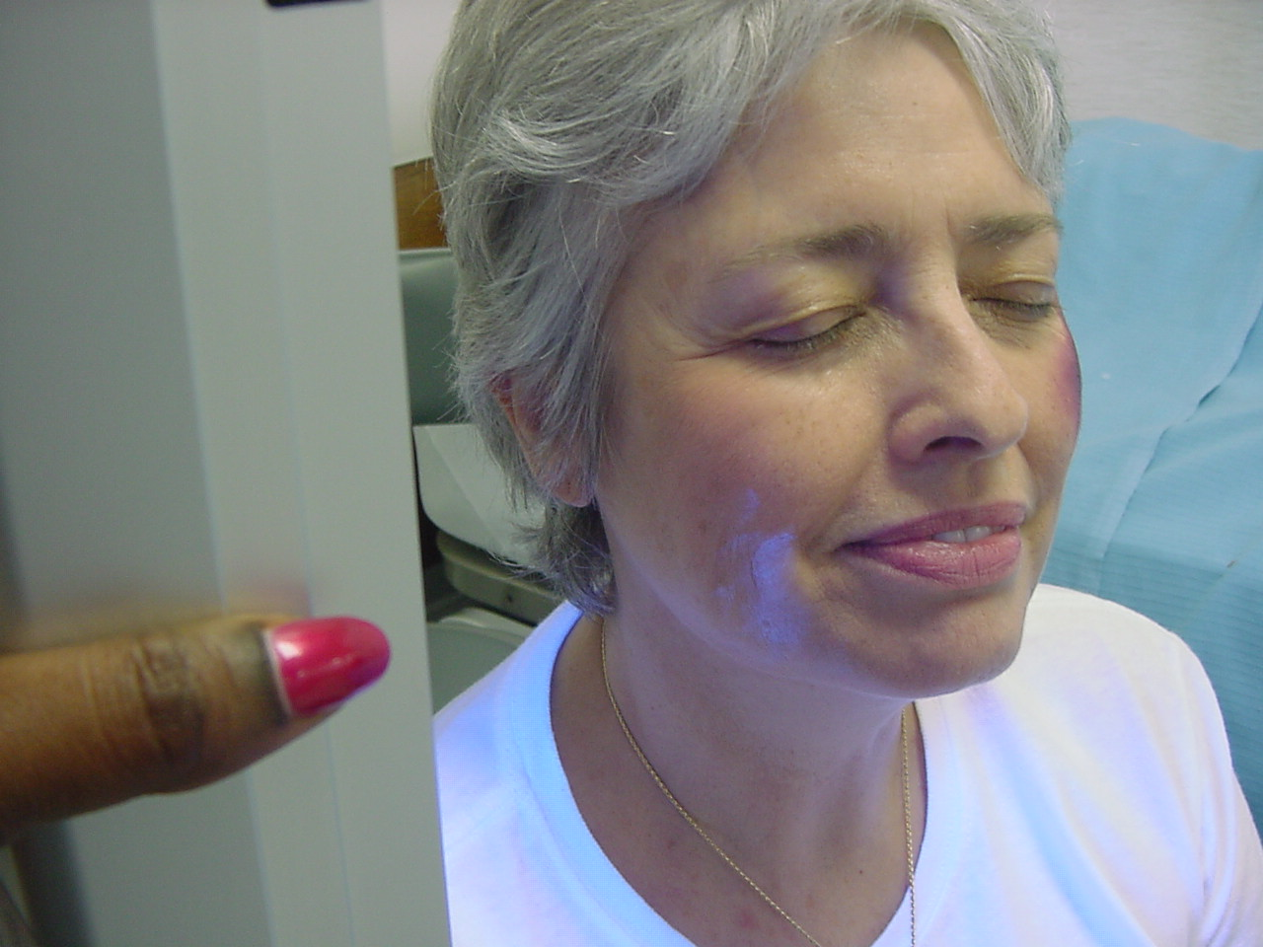

Slide 50
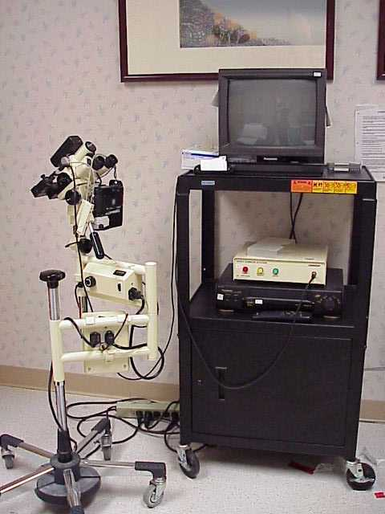
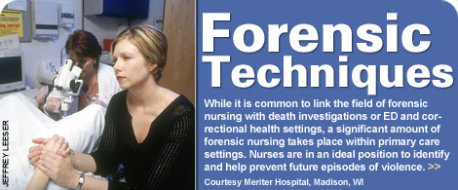
Colposcope

Slide 51
Sexual response may or may not occur
May provide explanation of findings
REMEMBER: the most common finding in the exam of the sexual assault victim is NO INJURY

Slide 52
Sexually Transmitted Infections
Gonorrhea
Trichomonas
Chlamydia
Syphilis
Herpes
Hepatitis
Lice
HIV (AIDS)
BV (Bacterial Vaginosis)
HPV (Human Pappillo Virus)
2015 CDC Guidelines:
www.cdc.gov/std/treatment/

Slide 53
Counseling – HIV Risk
Comparison to Occupational Exposure
  Risk conversion to HIV with Needle stick
    Patient known HIV positive
      1 out of 250 to 1 out of 333
Sexual Assault
  Risk of exposure lower
  HIV status of Assailant probably not known or available

Slide 54
Sexual Assault HIV Risk
Risk based on type of exposure
  Rectal – highest (50 out of 10,000)
  Vagina – intermediate (10 out of 10,000)
  Oral – lowest (1 out of 10,000)
  Genital or rectal tears or cuts will increase risk
Conversion usually within 2 – 6 weeks after exposure

Slide 55
Follow up for STIs
Where can the patient go?
GIVE CONDOMS!!
Serologic tests for syphilis and HIV at 6, 12, 24 wks
Hepatitis B vaccine 1-2 and 4-6 months
Genital inspection, pap 1-2 months
Where to go for follow up
  Health Department
  Private MD
  Return to ER

Slide 56
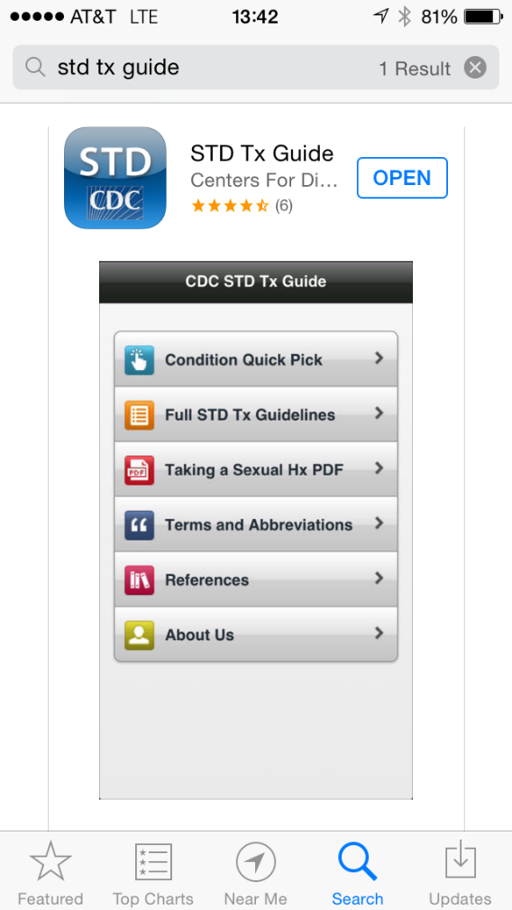
Theres an app for that…

Slide 57
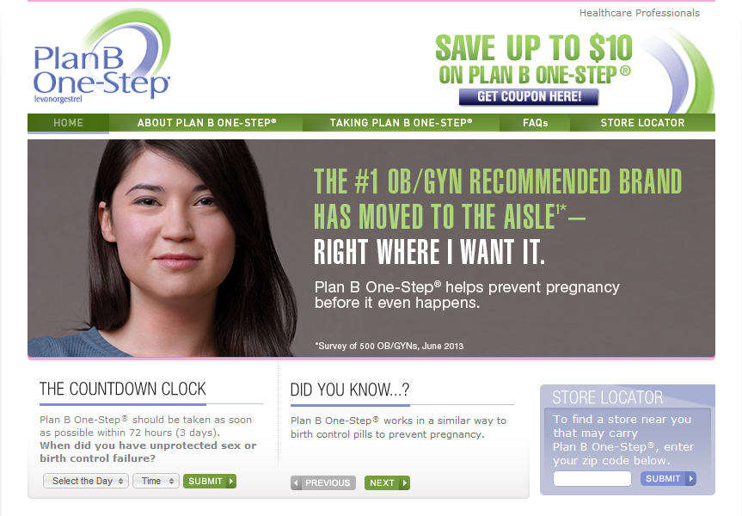
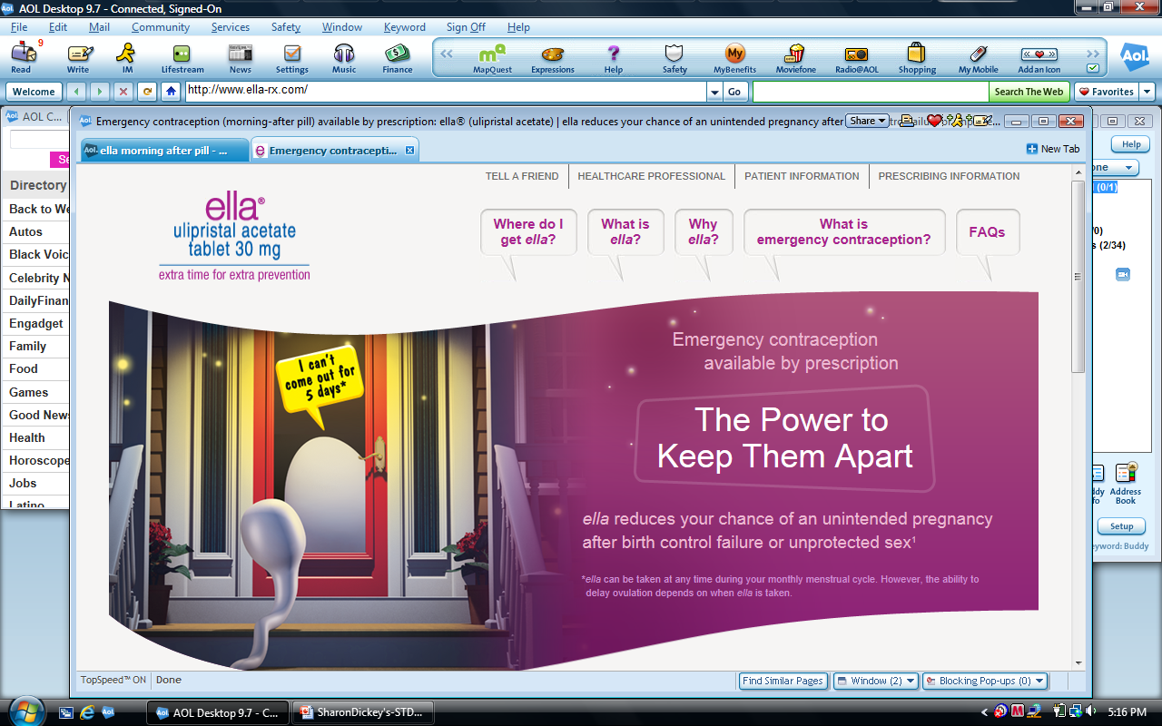
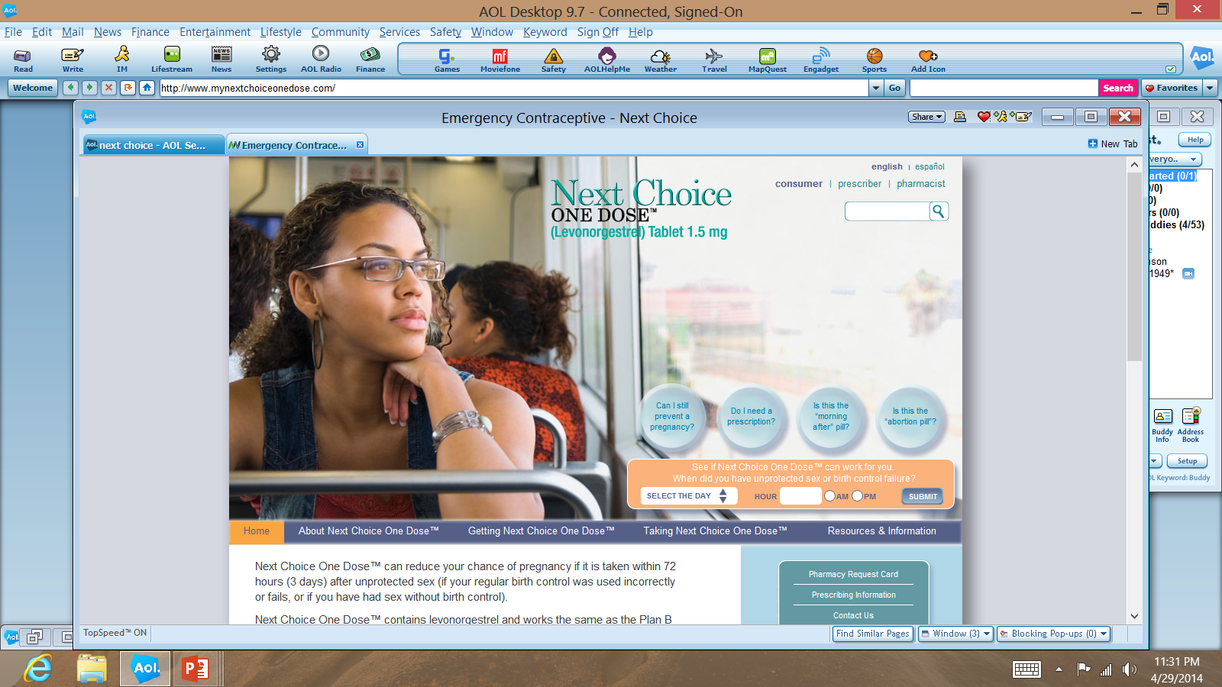

Slide 58
Standard of Care!
Standards of emergency care established by the American Medical Association (AMA) require that rape survivors be counseled about their risk of pregnancy and offered emergency contraception
(American Medical Association, "Strategies for the Treatment and Prevention of Sexual Assault" (1995), 18.)
ACEP, ACOG, AAP
Recognized by the CDC, IAFN, ANA, ENA

Slide 59
Directives for Catholic Health Care (#36)
Victim should be able to protect herself from pregnancy
No evidence of conception
Use medications that prevent ovulation, sperm capacitation, or fertilization
Do not harm or prevent implantation

Slide 60
PAYMENT OF
SEXUAL ASSAULT EXAM
MS Code § 99-37-25
State pays expense of med/forensic exam
  bill directly to Office of Attorney General
  No bill to patient
Other medical expenses – hospital stay, surgery, etc., can be covered, but not direct bill to Victim Comp.

Slide 61

Sexual Assault
Response Team
MEET one another!
Review all aspects of a community’s response to sexual assault
Identify duplication and gaps
Plan actions to meet needs
Requests and Offers
Evaluate

Slide 62
SANE Training Program
Based on National Training Models
  Department of Justice SANE Manual
  IAFN Standards
  Standards for Nursing Education
Developed by Experts:
  Nursing
  Legal
  Criminal Justice
Notes:
National Training Models
Definition of scope of practice
Nursing conceptual framework
Data collection
Nursing diagnoses
Care plan
Intervention
Evaluation
Safety
QA
Collaboration: joint training efforts
Research
Experts:
Nursing: Linda Ledray, Pat Speck, Colleen O’Brien
Legal: Patricia Moen, JD, Thomas Kiresuk, PhD, Lee Barry, JD
Criminal Justice: Ron C. Laney, DoJ, Kristen Grimmell, OVC

Slide 63
Course Content
Case Handling
Interviewing
Physical Exam
Forensic Photography
Evidence Collection
Follow up Care
Legal Issues and Testifying

Slide 64
NEXT SANE COURSE
November 18-22, Greenwood, MS
NO TUITION COST
40.5 Nursing CEU’s -- $50.00
E mail me for registration information:
  ShalottaSharp@aol.com

Slide 65
We’re Glad
You’re on the Team!
No difference in male and female Nurses/Advocates/LE
Victims want you to listen

Slide 66
A Team Approach to
Sexual Assault
Pre-Hospital Care: Emergency Services!
Law Enforcement
Medical/Hospital Personnel
Rape Crisis Center
Crime Lab
Prosecutors
Victim Compensation
Social Services

Slide 67
Before We Go…..
Sometimes people break the law……..
And its hard for us to do our job……
Self Care! Crime in Progress!

Slide 68
https://www.youtube.com/watch?v=LqRy3_5wHRM

Slide 69
Resources: Traumatic Stress
PTSD Alliance—1-877-507-PTSD (7873)
Sidran Traumatic Stress Foundation—www.sidran.org 1-410-825-8888
The International Society for TraumaticStress Studies—www.adaa.org 1-301-231-9350
The American College of Obstetricians and Gynecologists Women’s Health Care Physicians—www.acog.org 1-202-638-5577
Anxiety Disorders Association of America—www.adaa.org 1-231-9350

Slide 70
Sexual Assault Resources
www.forensicnurse.org (International Association of Forensic Nurses)
www.feminist.org/911/resources.html (sexual assault/rape crisis resource list)
www.rainn.org (state counseling centers—see sample MS map on next slide) National
Center for Victims of Crime www.ncvc.org/law/issues/spousalrape20.html

Slide 71
Shalotta Sharp, RN, SANE-A, SANE-P
Special Projects Coordinator
Mississippi Coalition Against Sexual Assault
(MSCASA)
P.O. Box 4172
Jackson, MS 39296
Cell-205-401-1171
ShalottaSharp@aol.com

