Slide 1
Creating Logic Model
Dr. Patricia Ann Davenport, CEO
Our House, Inc.

Slide 2
Agenda
Registration
Greet and Meet
1st Step – Creating Goal/Objective
Overview of Creating a Logic Model
Breakout Groups
Break
Putting the Pieces Together
Creating the Client’s Plan
Evaluation

Slide 3
First Steps

Slide 5
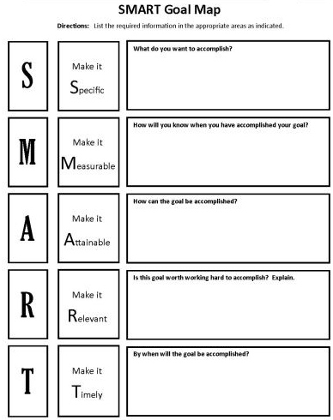

Slide 10
Some things to avoid when creating objectives
OBJECTIVES
must be achievable
AVOID
using terms that don’t allow a margin for error like always, every, each, all, never. An objective can be very challenging, but it should be possible for someone to achieve outstanding performance.
DON’T
describe objectives as things you don’t want done, focus on what you want achieved instead. There can’t be an expectation for a person to be perfect.

Slide 11
Advanced SMART goal tips and techniques
There’s three things left to do that’ll make the new objective work really well for you
Measurement
Performance standards, and
Actions
Let’s see what this looks like with our new objective (increase your Safety Score by 90%). We can break this objective down further:

Slide 12
Advanced SMART goal tips and techniques
Objective: Increase survivors’ safety
Measurement: A percentage score based on previous safety culture from client’s input.
Performance standard:
87 – 89% = partially met 90 – 95% = met 96 – 98% = exceeded over 98% = outstanding
The measurement makes it clear how the end result will be measured. It should describe both the source of the data and how it will be measured. The Performance standards explain a number of different levels of achievement.

Slide 13
Basic Outline of Logic Model

Slide 16
Logic Model
A logic model can be used throughout the lifecycle of your clients’ recovery process.

Slide 17
Conversation for Breakout Rooms
What is the problem the client is trying to solve or issue she/he is trying to address?
What specific activities will we undertake (e.g., convenings, press releases, training, direct services, advocacy, etc.) in order to address the problem or issue?
For each of the activities identified above, who are we trying to reach?
What resources are needed to successfully complete the activities identified? (e.g., time, talent, technology, information, money, community partnerships, etc.)

Slide 18
Conversation for Breakout Rooms
What changes do we expect to see as a result of their activities? (The timeframe below for short, intermediate and long term changes is only a suggestion. Use what makes sense for the client’s safety!)
What changes do you expect to see in the short term? (e.g., 1 year)
What changes do we expect as a result of short-term outcomes being achieved? (e.g., intermediate, 2-5 years)
What will be different if we are successful in the long term? (e.g., 5+ years)
What are the protective factors context in which the client can receive help from? Are there any factors that might influence its outcome that we should keep in mind?

Slide 19
Have you identified the outcomes? What do you want to see as a result of your actions?
Make sure your outcomes build on the activities and each other in a stepwise matter. By creating this logical progression, you can visually display progress toward your long-term goals. You may not be able to measure the longterm outcomes for awhile, but by measuring short-term and intermediate outcomes, you are able to demonstrate progress towards the goal you care about.
Short-term outcomes are changes you expect to see fairly quickly as a result of your program’s activities. Intermediate outcomes are often related to actions—e.g., changes in participants’ behaviors due to increased knowledge and changed attitudes.
Long-term outcomes are changes you expect to see in the later stages of your program, or even after the program is over, such as improved health status for program participants.

Slide 21
Stakeholders
Some questions to ask stakeholders to ensure a comprehensive logic model is developed:
Are there additional resources being used that are not reflected in the “inputs” column?
Do the activities listed represent your understanding of what is being carried out?
Are the objectives that the client listed being reached through the activities?
Are the outcomes what you expect to see as a result?
Are the outcomes reasonable to expect given the level of investment, timeline, and activities?

Slide 22
Stakeholders
Did you review the logic model with key Stakeholders (extended family, children, friends, or advocates) to ensure you have a common understanding of the safety elements?
When you share the logic model with stakeholders, stress to them that a logic model is always in draft form, as life is always changing and evolving to adapt to external conditions or internal changes.

Slide 24
Break Out Rooms
Inputs
Activities
Outcomes
Outputs

Slide 25
Did you test the logic of your logic model?
A logic model can work in both directions. Start from the left side if you are evaluating an existing goal. Start from the right side if you are developing an evaluation for a new goal for the clienty.
If you start from the left side, you can talk about how you are including specific inputs and activities “so that” you can achieve short and long term changes that are the goal of your client’s plan for safety.
If you start from the right side, test it by walking backwards from long-term outcomes and asking a series of “how?” questions.

Slide 26
